Slide 1


SPIE Photonics Europe
Strasbourg 29 March - 2 April 2020
Digital Forum 6-10 April 2020
New perspectives
in Correlation Plenoptic Imaging
Francesco V. Pepe
Università degli Studi di Bari, Italy
Istituto Nazionale di Fisica Nucleare (INFN) – Sezione di Bari, Italy
francesco.pepe@ba.infn.it
in collaboration with
F. Di Lena, M. D’Angelo, A. Garuccio, A. Scagliola
G. Scala, S. Pascazio (Univ. Bari)
G. Scarcelli (Univ. Maryland, College Park)

Slide 2
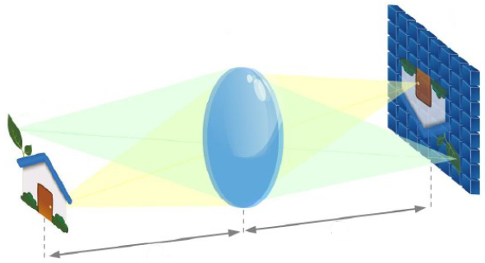
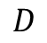
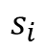
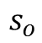
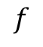
Optical imaging
$$f$$
Relevant parameters:
Focal length f
Numerical aperture D/2f
Light wavelength λ
$$D$$
$$s_{i}$$
$$s_{o}$$
Figures of merit: resolution, depth of field, signal-to-noise ratio (SNR), aberration correction/limitation
but…
Resolution vs depth of field
Depth of field vs SNR
SNR vs aberrations
Resolution vs aberrations
in correlation imaging: resolution vs SNR
TRADEOFFS

Slide 3
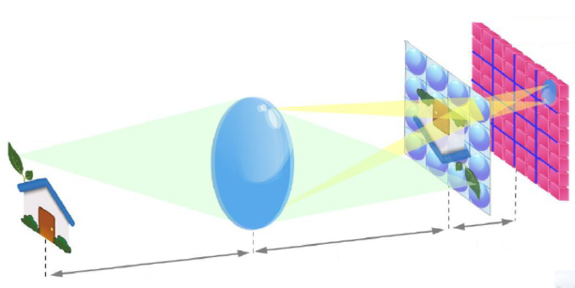
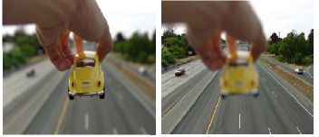
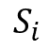
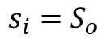
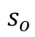
Plenoptic imaging
Combined imaging of the object and the main lens to reconstruct the direction of light → DOF increase, refocusing, change of point of view, 3D reconstruction in post processing
Microlens
array
Lippman (1908), Adelson and Wang (1992)
Ng (2005)
$s_{i}=$ $S_{o}$
$$s_{o}$$
$$S_{i}$$
Depth of field is increased without losing signal-to-noise ratio…
From lytro.com (discontinued)

Slide 4
Plenoptic imaging
Combined imaging of the object and the main lens to reconstruct the direction of light → DOF increase, refocusing, change of point of view, 3D reconstruction in post processing
Microlens
array
Lippman (1908), Adelson and Wang (1992)
Ng (2005)
$s_{i}=$ $S_{o}$
$$s_{o}$$
$$S_{i}$$
… however spatial resolution is reduced by a factor coinciding with directional resolution
From lytro.com (discontinued)

Slide 5
Plenoptic imaging: applications
Use of image reconstruction or deconvolution techniques to recover lost resolution

Slide 6
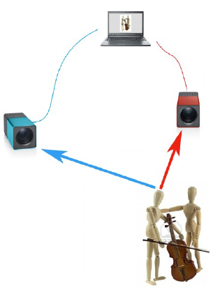
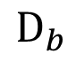
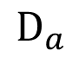
Correlation Plenoptic Imaging: principle
Main idea: use correlation imaging to avoid resolution loss
Propagate two correlated light beams; at least one of them interacts with the object
Follow in time the intensitites at their ends with two spatially resolving detectors D_{a} and D_{b}
Time-average to evaluate point-to-point correlations of intensity fluctuations
$$D_{b}$$
$$D_{a}$$
D’Angelo et al, PRL 116, 223602 (2016)
Patent IT102016000027106 (2016)

Slide 7
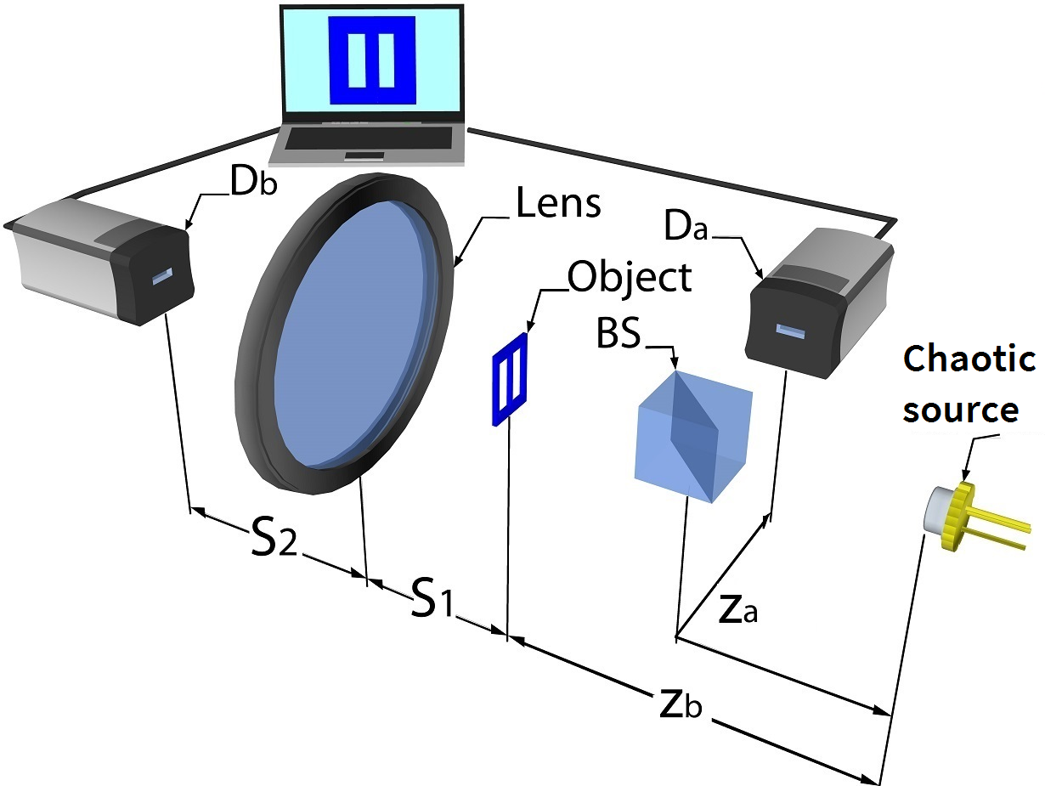
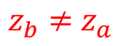
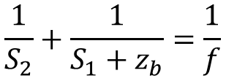
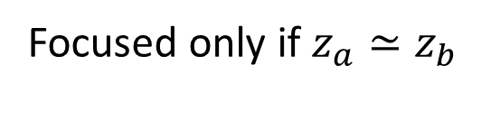
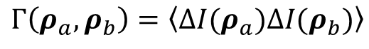
Correlation Plenoptic Imaging: first realization
Measurement
$z_{b}≠$ $z_{a}$
$$Γ\left(ρ_{a},ρ_{b}\right)=\left\langle ΔI(ρ_{a})ΔI(ρ_{b})\right\rangle$$
Summing correlations over D_{b} yields the incoherent ghost image of the object
$$\frac{1}{S_{2}}+\frac{1}{S_{1}+z_{b}}=\frac{1}{f}$$
Focused only if $z_{a}≃z_{b}$
Multiple images of the object detected by the sensor D_{a} (one for each pixel of D_{b})
Combined to refocus and change point of view

Slide 8
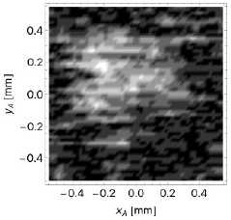
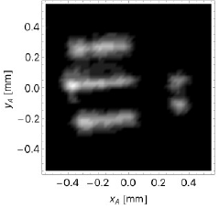
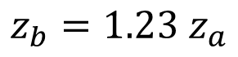
Correlation Plenoptic Imaging: first realization
$$z_{b}=1.23 z_{a}$$
$z_{b}≠$ $z_{a}$
Ghost image
Refocused image
$$\frac{1}{S_{2}}+\frac{1}{S_{1}+z_{b}}=\frac{1}{f}$$
Pepe et al, PRL 119, 243602 (2017)

Slide 9
Correlation Plenoptic Imaging: first realization
$$z_{b}=1.23 z_{a}$$
$z_{b}≠$ $z_{a}$
Ghost image
Refocused image
$$\frac{1}{S_{2}}+\frac{1}{S_{1}+z_{b}}=\frac{1}{f}$$
Drawbacks:
Low SNR: inherits the typical resolution-SNR tradeoff of ghost imaging → no p.o.v. change!
Impossibility to monitor the object in real time
Pepe et al, PRL 119, 243602 (2017)

Slide 10
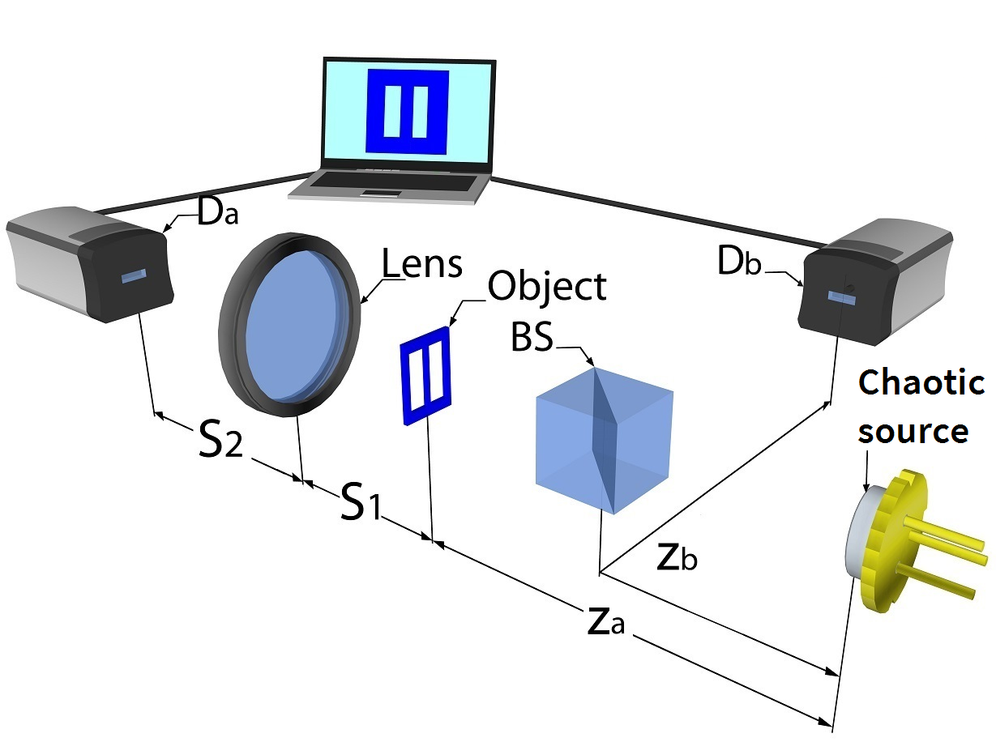
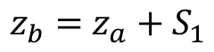
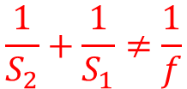
CPI: an alternative architecture
Measurement
$$Γ\left(ρ_{a},ρ_{b}\right)=\left\langle ΔI(ρ_{a})ΔI(ρ_{b})\right\rangle$$
$z_{b}=$ $z_{a}+S_{1}$
The image of the object (not necessarily focused) is formed on D_{a} by an ordinary lens.
D_{b} detects the focused ghost image of the lens. This enables to reconstruct and select the direction of light.
$$\frac{1}{S_{2}}+\frac{1}{S_{1}}≠\frac{1}{f}$$
Advantages:
Higher SNR: noise is not negatively affected by spatial resolution
The scene can be observed even by direct intensity measurement (with no refocusing)
Pepe et al, J. Opt. 19, 114001 (2017)
Scala et al, PRA 99, 053808 (2019)
Pat. appl. PCT/IB2017/055842 (2017)

Slide 11
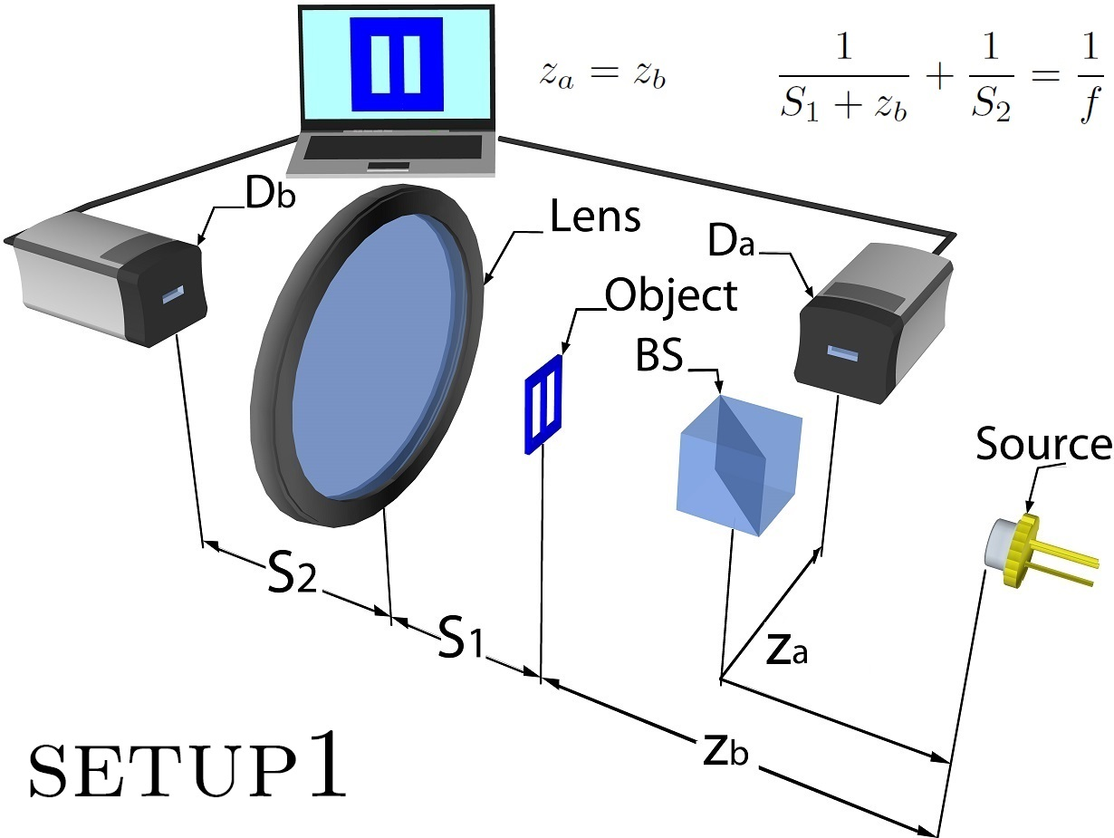
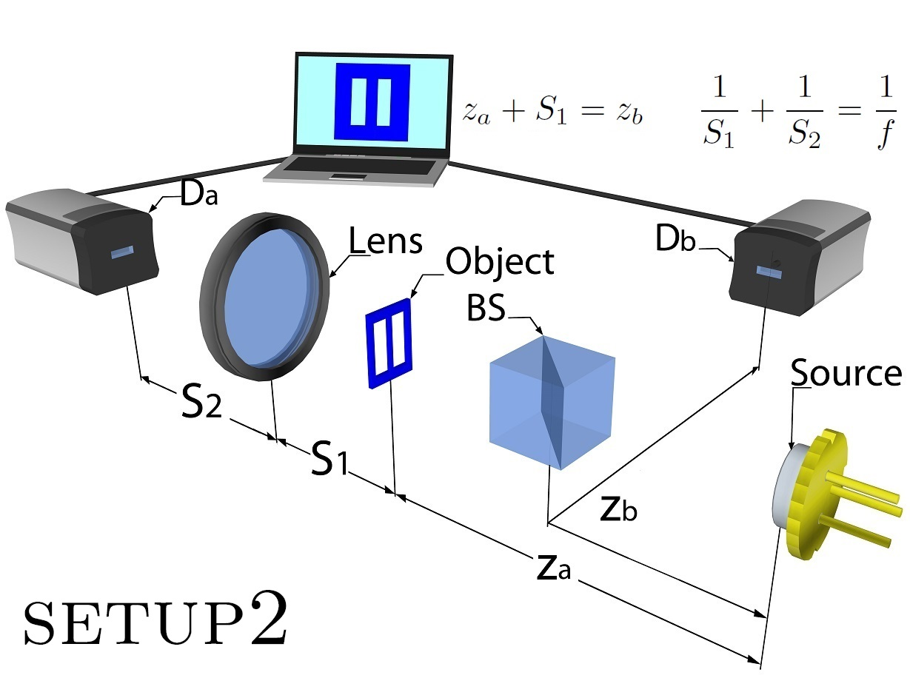
General limitations of CPI
In these setups, the direction of light before and after the object must change in a predictable way: transmission, mirror-like reflection.
This condition rules out relevant categories for microscopy:
Diffusive objects
Objects surrounded by a scattering medium or turbulence
Randomly emitting samples (e.g. fluorescent)

Slide 12
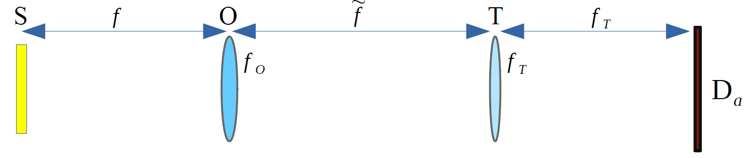
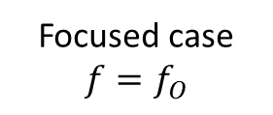
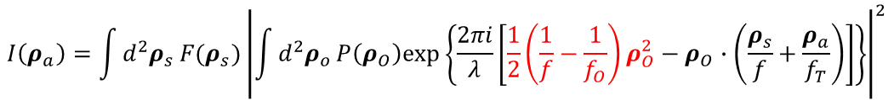
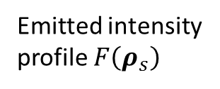
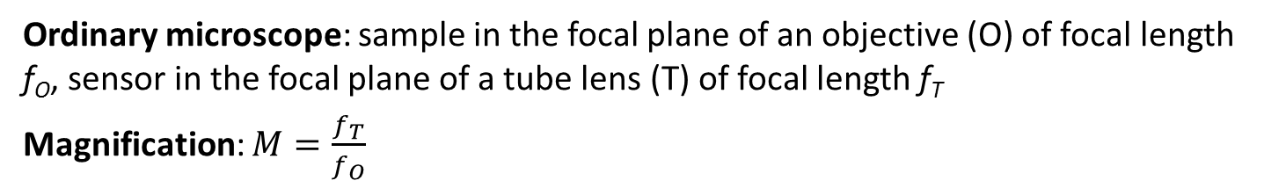
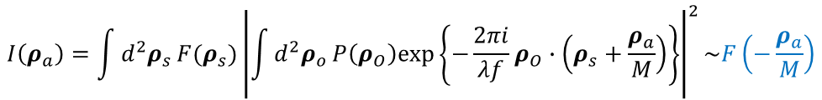
The Correlation Plenoptic Microscope
Ordinary microscope: sample in the focal plane of an objective (O) of focal length f_{O}, sensor in the focal plane of a tube lens (T) of focal length f_{T}
Magnification: $M=\frac{f_{T}}{f_{O}}$
Emitted intensity profile $F\left(ρ_{s}\right)$
Focused case
$${f=f}_{O}$$
$$I\left(ρ_{a}\right)=\int{d^{2}ρ_{s}}F(ρ_{s}){\left|\int{d^{2}ρ_{o}}P\left(ρ_{O}\right)exp\left\{−\frac{2πi}{λf}ρ_{O}∙\left(ρ_{s}+\frac{ρ_{a}}{M}\right)\right\}\right|}^{2}\sim F\left(−\frac{ρ_{a}}{M}\right)$$
Arbitrary sample distance
$$I\left(ρ_{a}\right)=\int{d^{2}ρ_{s}}F(ρ_{s}){\left|\int{d^{2}ρ_{o}}P\left(ρ_{O}\right)exp\left\{\frac{2πi}{λ}\left[\frac{1}{2}\left(\frac{1}{f}−\frac{1}{f_{O}}\right)ρ_{O}^{2}−ρ_{O}∙\left(\frac{ρ_{s}}{f}+\frac{ρ_{a}}{f_{T}}\right)\right]\right\}\right|}^{2}$$

Slide 13
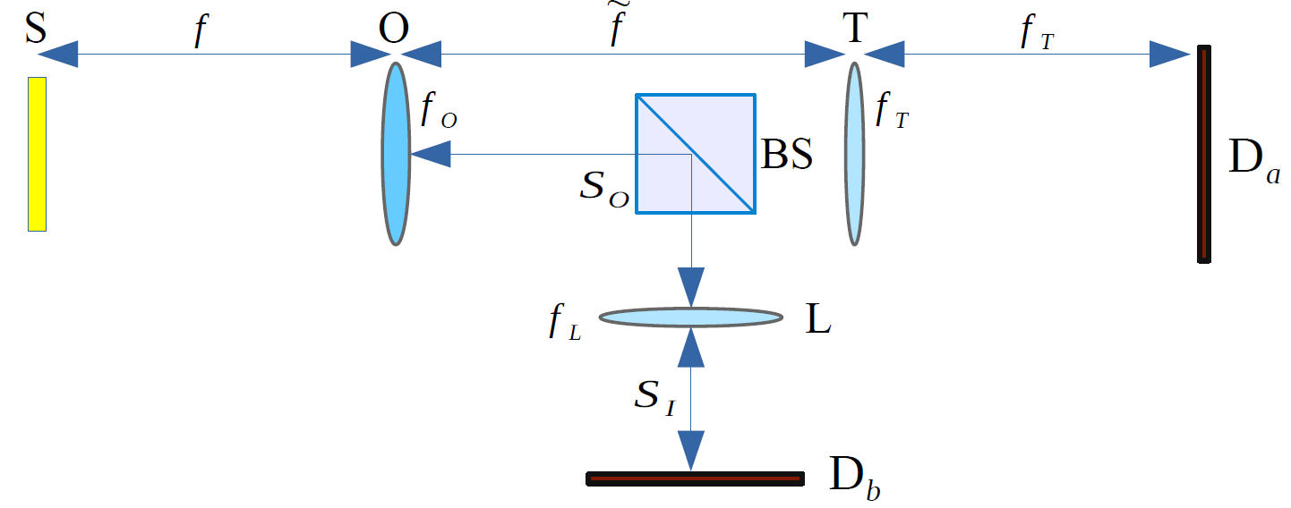
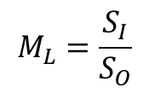
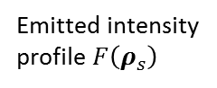
The Correlation Plenoptic Microscope
Correlation Plenoptic Microscope: correlated imaging of the objective focal plane and of the objective surface
Emitted intensity profile $F\left(ρ_{s}\right)$
$$M_{L}=\frac{S_{I}}{S_{O}}$$
Intensity correlator
Arbitrary sample distance f
$$Γ\left(ρ_{a},ρ_{b}\right)={\left|\int{d^{2}ρ_{s}}F(ρ_{s})\int{d^{2}ρ_{o}}P\left(ρ_{O}\right)exp\left\{\frac{2πi}{λ}\left[\frac{1}{2}\left(\frac{1}{f}−\frac{1}{f_{O}}\right)ρ_{O}^{2}−ρ_{O}∙\left(\frac{ρ_{s}}{f}+\frac{ρ_{a}}{f_{T}}\right)−\frac{ρ_{b}∙ρ_{s}}{M_{L}f}\right]\right\}\right|}^{2}$$
D’Angelo, Di Lena, Garuccio, Pepe, Scagliola, patent appl. IT102018000007857 (2018),
Paper on theory under peer review; paper on experiment in preparation.

Slide 14
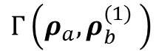
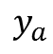
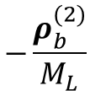
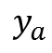
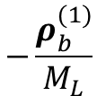
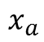
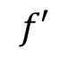
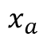
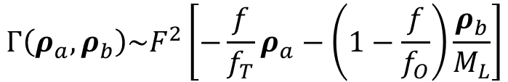
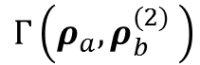
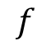
CPM: change of point of view
$$Γ\left(ρ_{a},ρ_{b}\right)\sim F^{2}\left[−\frac{f}{f_{T}}ρ_{a}−\left(1−\frac{f}{f_{O}}\right)\frac{ρ_{b}}{M_{L}}\right]$$
Geometrical-optics limit
The transverse shift of the image depends on the selected point${ (−ρ}_{b}/M_{L})$ of the objective surface and on the longitudinal distance f from the objective
SAMPLE
OBJECTIVE LENS
$$Γ\left(ρ_{a},ρ_{b}^{(1)} \right)$$
$$−\frac{ρ_{b}^{(1)}}{M_{L}}$$
$$y_{a}$$
$$x_{a}$$
$$Γ\left(ρ_{a},ρ_{b}^{(2)} \right)$$
$$−\frac{ρ_{b}^{(2)}}{M_{L}}$$
$$y_{a}$$
$$f$$
$$f′$$
$$x_{a}$$

Slide 15
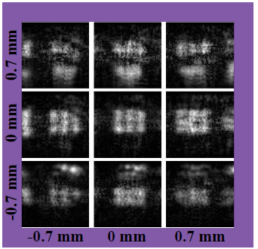
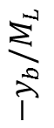
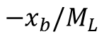
CPM: change of point of view
Out-of-focus triple slit
(planar object)
$$Γ\left(ρ_{a},ρ_{b}\right)\sim F^{2}\left[−\frac{f}{f_{T}}ρ_{a}−\left(1−\frac{f}{f_{O}}\right)\frac{ρ_{b}}{M_{L}}\right]$$
9 panels
9 points on the objective
9 points of view
$${−y}_{b}/M_{L}$$
Center-to-center slit distance:
d =39.37 μm
Objective focal length: f_{O} = 25.6 mm
Tube focal length: f_{T} = 175.0 mm
Object distance: f = 24.5 mm
Number of frames: N_{fr} = 30k
$${−x}_{b}/M_{L}$$

Slide 16
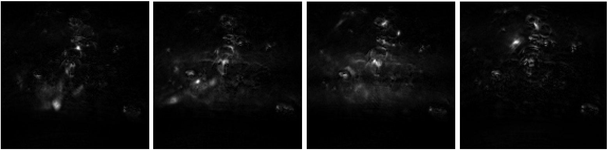

CPM: change of point of view
Starch aggregates dispersed in gel (3D sample)
$$Γ\left(ρ_{a},ρ_{b}\right)\sim F^{2}\left[−\frac{f}{f_{T}}ρ_{a}−\left(1−\frac{f}{f_{O}}\right)\frac{ρ_{b}}{M_{L}}\right]$$
Scagliola et al, in preparation
- 4.17 mm - 1.39 mm 1.39 mm 4.17 mm
$${−x}_{b}/M_{L}$$
Objective focal length: f_{O} = 25.6 mm
Tube focal length: f_{T} = 175.0 mm
Number of frames: N_{fr} = 30k
Detail recovery
3D rendering

Slide 17






CPM: refocusing
Refocusing algorithm based on the geometrical-optics properties of $Γ(ρ_{a},ρ_{b})$
$$Σ_{ref}\left(ρ_{a}\right)=\int{d^{2}ρ_{b}Γ\left[\frac{f_{O}}{f}ρ_{a}+\left(1−\frac{f_{O}}{f}\right)\frac{M}{M_{L}}ρ_{b},ρ_{b}\right]\sim F^{2}\left(−\frac{ρ_{a}}{M}\right)}$$
Standard image
REFOCUSING
Center-to-center slit distance: d = 39.37 μm
Distance from focal plane: f – f_{O} = – 1.1 mm
CASE
A
Center-to-center slit distance: d = 39.37 μm
Distance from focal plane: f – f_{O} = + 1.1 mm
CASE
B
distance from focal plane [mm]

Slide 18

CPM: refocusing
Refocusing algorithm based on the geometrical-optics properties of $Γ(ρ_{a},ρ_{b})$
$$Σ_{ref}\left(ρ_{a}\right)=\int{d^{2}ρ_{b}Γ\left[\frac{f_{O}}{f}ρ_{a}+\left(1−\frac{f_{O}}{f}\right)\frac{M}{M_{L}}ρ_{b},ρ_{b}\right]\sim F^{2}\left(−\frac{ρ_{a}}{M}\right)}$$
Starch sample
Refocused plane variation

Slide 19

CPM: refocusing
Refocusing algorithm based on the geometrical-optics properties of $Γ(ρ_{a},ρ_{b})$
$$Σ_{ref}\left(ρ_{a}\right)=\int{d^{2}ρ_{b}Γ\left[\frac{f_{O}}{f}ρ_{a}+\left(1−\frac{f_{O}}{f}\right)\frac{M}{M_{L}}ρ_{b},ρ_{b}\right]\sim F^{2}\left(−\frac{ρ_{a}}{M}\right)}$$
Section of bovine cornea: birefringent collagen fibers
Focused image
100 μm out of focus
Refocusing
60 μm

Slide 20


CPI between arbitrary planes
Single-lens CPI device
The lens focuses two different planes inside a 3D object on D_{a} and D_{b}
$$\frac{1}{z_{a}}+\frac{1}{{z′}_{a}}=\frac{1}{f}$$
$$\frac{1}{z_{b}}+\frac{1}{{z′}_{b}}=\frac{1}{f}$$
CPI refocusing
Francesco Di Lena, PhD thesis (2019)
Patent application PCT/IB2019/052351 (2019)

Slide 21
CPI between arbitrary planes
Entangled photon illumination
Work in progress on:
Theory: SNR, investigation of different correlation protocols (e.g. differential correlation imaging)
Experiment: noise reduction factor (found <1), refocusing
Collaboration with
A. Avella and I. Ruo-Berchera (INRIM)
Francesco Di Lena, PhD thesis (2019)
E. De Scisciolo et al. Int. J. Quantum Inf. (2020)

Slide 22
Other perspectives
Scientific-technological challenges toward real-world applications:
Improvement of SNR by optimizing setups, sources and correlation measurement protocols
Reduction of detection times (SPAD arrays as ultrafast detectors, use of compressive sensing techniques, …)
Superresolution
Application testbeds:
Biomedical samples
Imaging from/of space
…
SUPPORT:
PICS – Plenoptic Imaging with Correlations: young researcher grant of INFN (2017-2019)
CLOSE – Close to Earth: PON ARS project of the Italian Ministry of Education, University and Research (2019-)

Slide 23




QuOT Lab+Theory group @ UniBA
Students :
Davide Giannella, Alessandro Lupo
Emiliana De Scisciolo, Francesco Di Lena, Aldo Mazzilli
Giovanni Scala
Researchers:
Alessio Scagliola
Gianlorenzo Massaro
Francesco V. Pepe
Milena D'Angelo
Augusto Garuccio
Collaborations:
Univ. Maryland (USA)
INRIM Torino (IT)
EPFL (CH)
Planetek (IT/GR)
Univ. Olomouc (CZ)
Contact:
milena.dangelo@uniba.it
PICS
PICS4ME
Qu3D

